Slide 1

Blinking Extraction in Eye gaze System for Stereoscopy Movies
Filip Rynkiewicz
Piotr Napieralski
Notes:
Hello,
My name is Filip Rynkiewicz from Technical University of Lodz and I’m here to talk about blinking extraction in Eye gaze systems for stereoscopy movies. I will start with agenda.

Slide 2
Agenda
Eye gaze systems:
Human eye
Eye detection and eye detection device
Blink:
Eye lid closed
Blink detection
Notes:
First of all i will talk about eye gaze systems including human eye build and nature, how to detect an eye and what devices can be used to do that. Than i will focus on blinks, what they are why they are need and how to detect them.

Slide 3
Human Eye
How is it build ?
Notes:
Lets start with biology of human eye

Slide 4
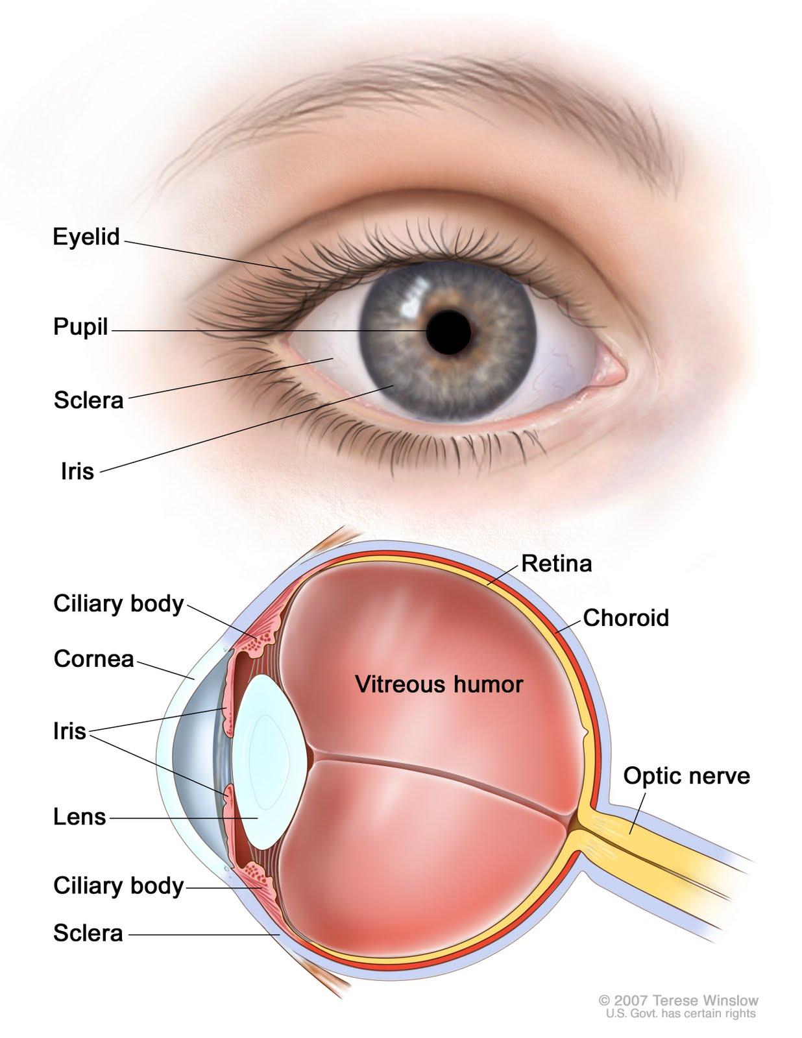
Retina is a light-sensitive layer of tissue.
Pupil is a hole located in the center of the iris of the eye that allows light to strike the retina.
Iris is a thin, circular structure in the eye, responsible for controlling the diameter and size of the pupil and thus the amount of light reaching the retina.
Eye lid is a thin fold of skin that covers and protects the human eye.
Picture 1. Anatomy of the eye
Notes:
Picture presented shows the anatomy of human eye. The most important pieces of it, for this topic, are retina pupul iris and eye lid.

Slide 5
Eye gaze detection methods
How to find where are we looking?
Notes:
If you know how eye is build let’s take step further and try to detect where are we looking. So how to find a gaze point?

Slide 6
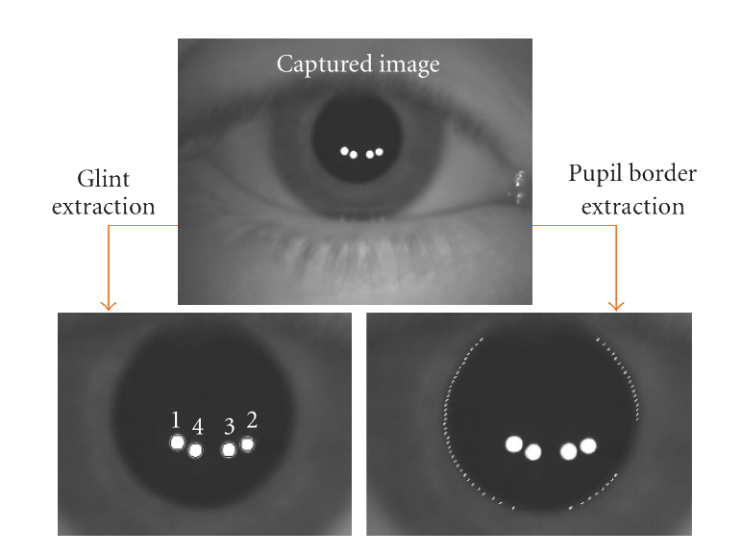
Picture 2. Eye gaze position methods
Notes:
This diagram shows two methods to locate human eye on picture, and then combine them to locate the gaze point.
First one is based on glit detection. What glints are? There are reflection of light sources needed to locate the eye position referenced to the light source. When eyes are moving those points will be change thus the 3d position of the eye can be calculated.
Second method is based on shape, in this example the pupil border. There are multiple other techniques such like detecting pupil center, pupil ellipse.

Slide 7
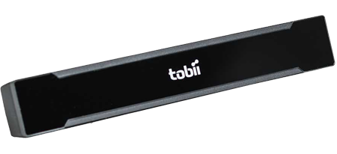

Example devices
Picture 3. Tobii X2-60
Picture 4. EyeTribe
Notes:
Currently we have been testing both devices. One is Tobii X2 with 60Hz and EyeTribe capable of sampling data with 30 and 60 Hz. Those are the most common devices to do such research. But if it comes to detect eye blinks another support device was used. Go Pro camera to record face of the examinated. Both devices have big problem with blink detection, most of time those divices interprets squinting as the blink, had problems with record when the responded moves. So what to do when the eye lid is closed?

Slide 8
Closing the eyelid
What will happen when you close you eye?

Slide 9
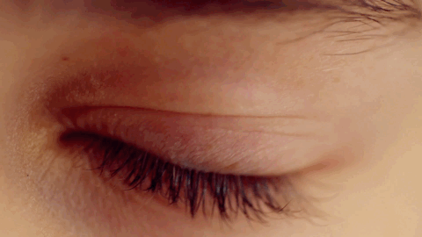
Nature of blink
Blinking is semi-autonomic rapid closing of the eyelid.
Picture 5. Animation of blink
Notes:
Blink will close your aye, its natural. But how the eyeTracker device will detect it if almost all of it’s algorithms are based on pupil detection or reflection on the pupil?

Slide 10
Blink detection methods
How to catch a blink?

Slide 11
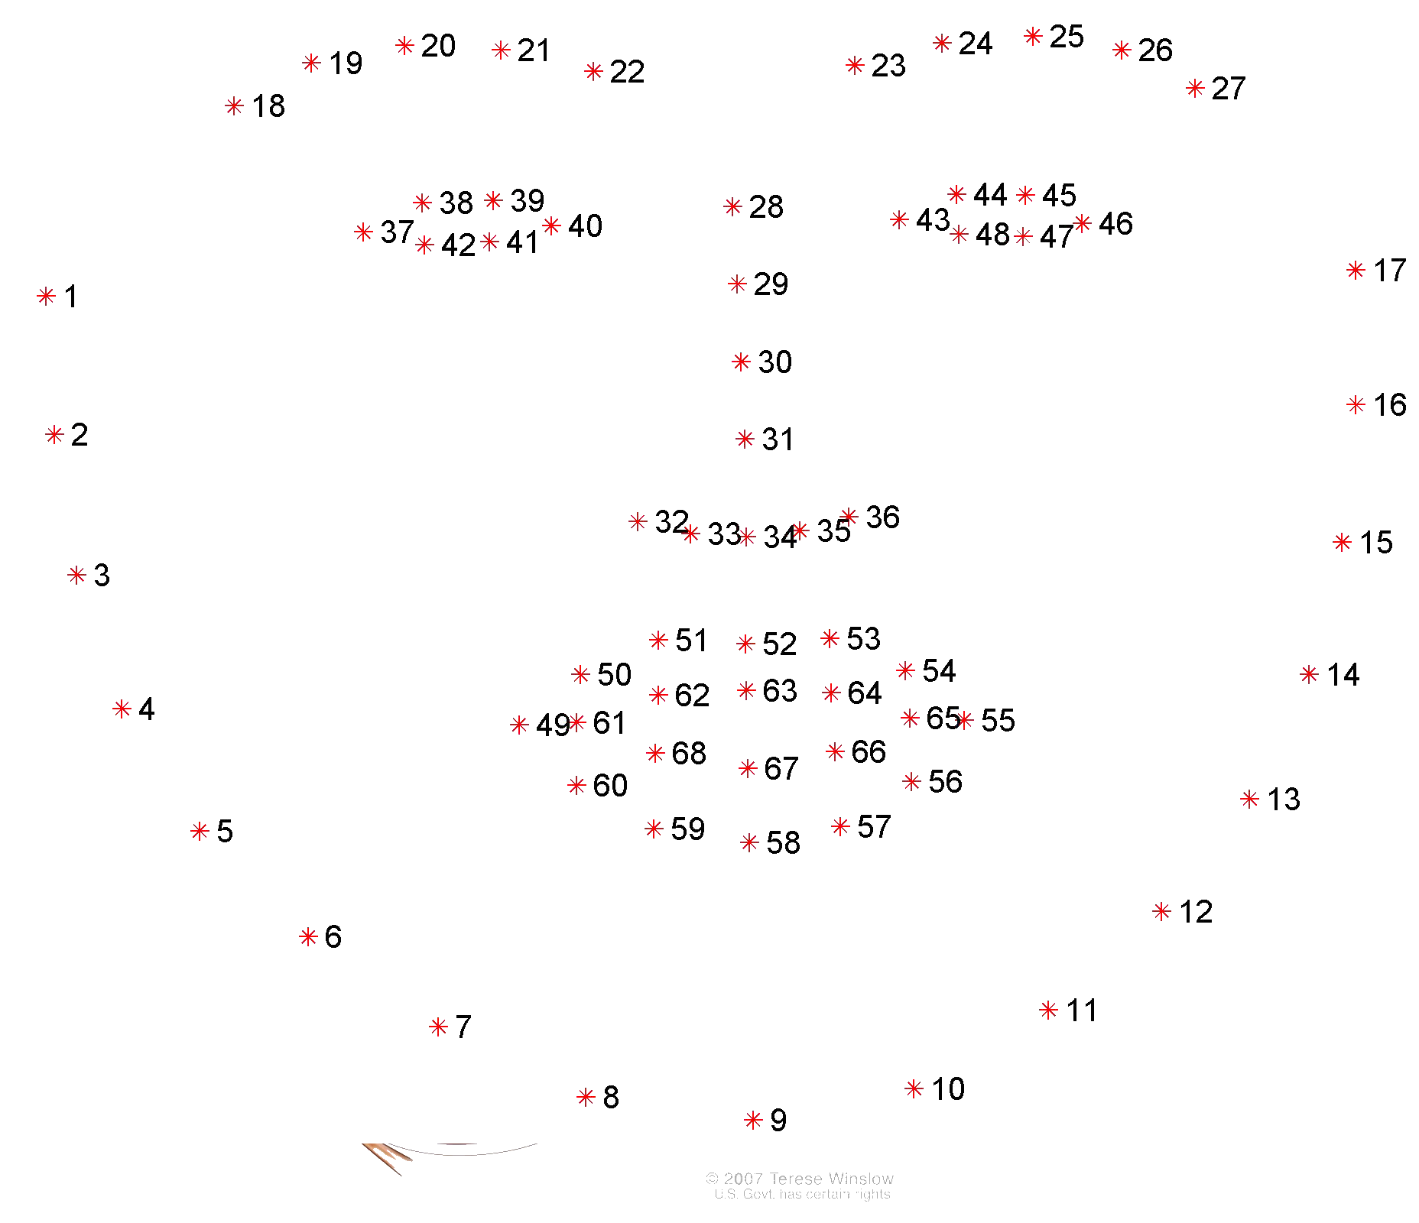
Facial landmarks
Picture 6. Facial landmarks points
Notes:
Those points are representatives of specific position on human face. Getting them to groups we can find nose, eyes, lips, theys movement and their 3d positions. But if we don’t have full face to do it?

Slide 12
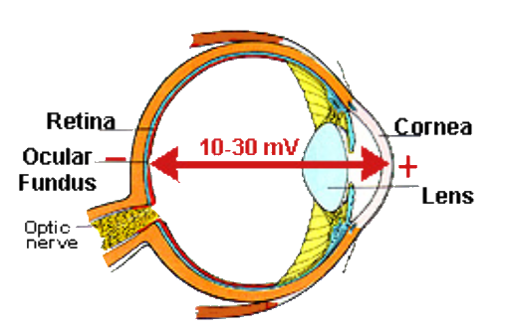
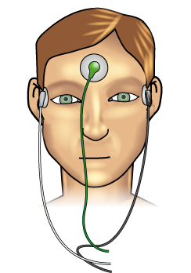
Electrooculography
Picture 7. Electic potencials in eye
Picture 8. EOG electrode placement
Notes:
This idea called EOG is based on the differences between potentials of the eye. When it’s moved the electric field changes and it can be observed. Those differences can be measure and thanks to it the eye movement or the blinks can be excavated.

Slide 13
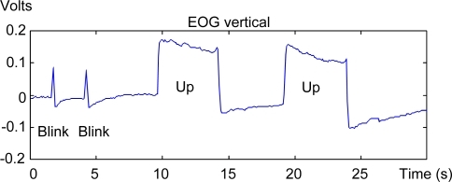
Blink and Up eye movement
Picture 9. EOG signal
Notes:
This sample shows how the blink is registered int the EOG signal. As it can be seen it’s very fast up and it’s combination of up and down movement.

Slide 14
But why we blinked?
Notes:
And this isi the question I will be asking myself in my future work. How to find out why we have blinked? Are we bored, can it be the first stage of some kind of disease?

Slide 15
THANKS!
Any questions?
You can find me at:
filip.rynkiewicz@dokt.p.lodz.pl

Slide 16

And remember

